Slide 1
Intelligent Agents
Course Code: CSC4226
Course Title: Artificial Intelligence and Expert System
Dept. of Computer Science
Faculty of Science and Technology
Lecture No: | Two (2) | Week No: | Two (2) | Semester:
Lecturer: | Dr. Abdus Salam Mail: abdus.salam@aiub.edu

Slide 2
Lecture Outline
Agents and Environments
Good Behavior: The Concept of Rationality
The Nature of Environments
The Structure of Agents

Slide 3
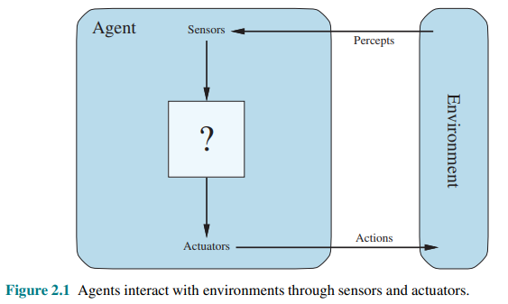
AGENT
An agent is anything that can be viewed as perceiving its environment through sensors and acting upon that environment through actuators.

Slide 4
INTELLIGENT AGENT
Agent: An entity in a program or environment capable of generating action.
An agent uses perception of the environment to make decisions about actions to take.
The perception capability is usually called a sensor.
The actions can depend on the most recent perception or on the entire history (percept sequence).

Slide 5
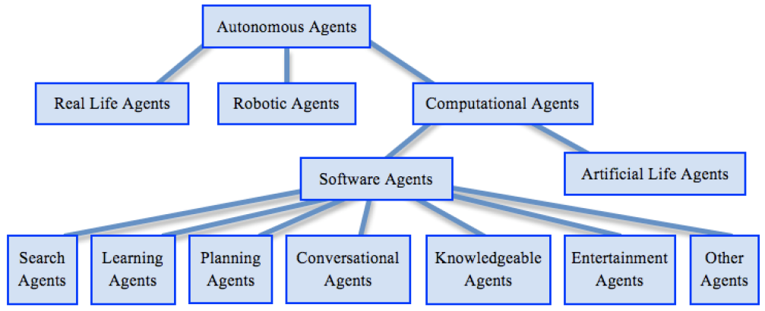
TAXONOMY OF AUTONOMOUS AGENT

Slide 6
AGENT V/S PROGRAM
Size - an agent is usually smaller than a program.
Purpose - an agent has a specific purpose while programs are multi-functional.
Persistence - an agent's life span is not entirely dependent on a user launching and quitting it.
Autonomy - an agent doesn't need the user's input to function.

Slide 7
DIFFERENT AGENTS
A human agent has eyes, ears, and other organs for sensors and hands, legs, vocal tract, and so on for actuators.
A robotic agent might have cameras and infrared range finders for sensors and various motors for actuators.
A software agent receives keystrokes, file contents, and network packets as sensory inputs and acts on the environment by displaying on the screen, writing files, and sending network packets.

Slide 8
AGENTS
The term percept refers to the agent’s perceptual inputs at any given instant.
An agent’s percept sequence is the complete history of everything the agent has ever perceived.
In general, an agent’s choice of action at any given instant can depend on the entire percept sequence observed to date, but not on anything it hasn’t perceived.

Slide 9
AGENT FUNCTION
The agent’s choice of action for every possible percept sequence can be defined.
An agent’s behavior is described by the agent function that maps any given percept sequence to an action.
We can imagine tabulating the agent function that describes any given agent; for most agents, this would be a very large table—infinite, in fact, unless we place a bound on the length of percept sequences we want to consider.

Slide 10
AGENT PROGRAM
The table can be constructed by trying out all possible percept sequences and recording which actions the agent does in response. Thus, the table is, of course, an external characterization of the agent. Internally, the agent function for an artificial agent will be implemented by an agent program.
It is important to keep these two ideas distinct. The agent function is an abstract mathematical description; the agent program is a concrete implementation, running within some physical system.

Slide 11
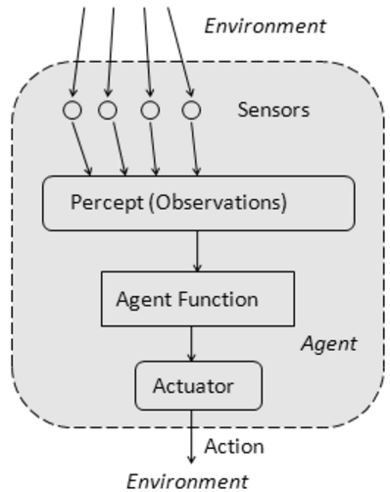
AGENT FUNCTION
The agent function is a mathematical function that maps a sequence of perceptions into action.
The function is implemented as the agent program.
The part of the agent taking an action is called an actuator.
environment -> sensors -> agent function -> actuators -> environment

Slide 12
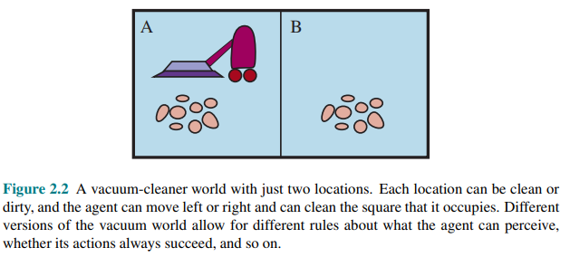
VACUUM CLEANING AGENT

Slide 13
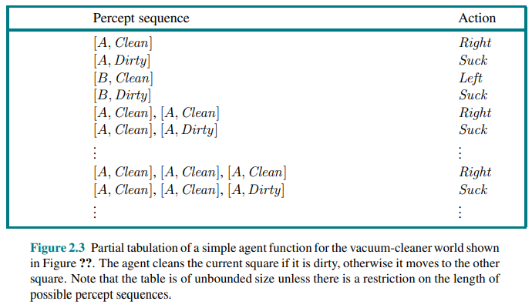
VACUUM CLEANING AGENT

Slide 14
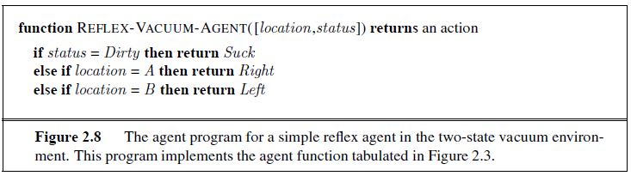
VACUUM CLEANING AGENT

Slide 15
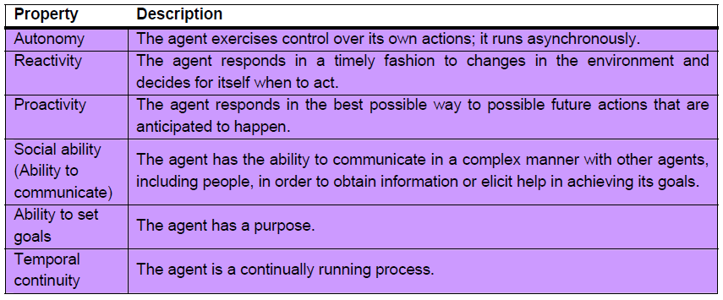
DESIRABLE PROPERTIES OF AGENT

Slide 16
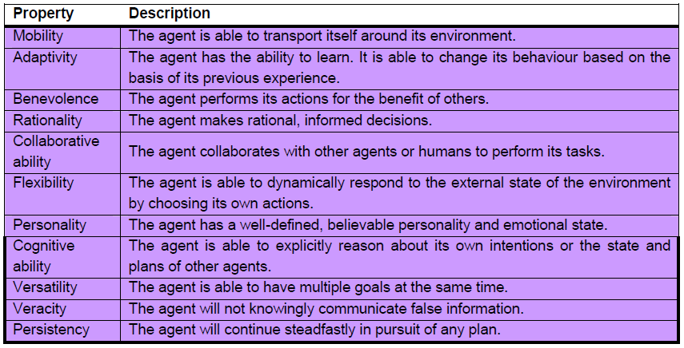
DESIRABLE PROPERTIES OF AGENT
Continued..

Slide 17
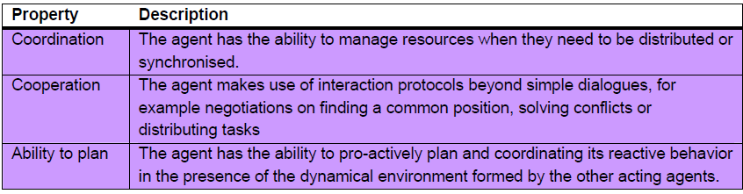
DESIRABLE PROPERTIES OF AGENT
Continued..

Slide 18
GOOD BEHAVIOR: THE CONCEPT OF RATIONALITY
Rational Agent
- one does the right thing
- Every entry in the table for the agent function is filled out correctly
What does it mean to do the right thing ?
by considering the consequences of the agent's behavior
When an agent is plunked down in an environment, it generates a sequence of actions according to the percepts it receives.
This sequence of actions causes the environment to go through a sequence of states. If the sequence is desirable, then the agent has performed well.
This notion of desirability is captured by a performance measure that evaluates any given sequence of environment states.

Slide 19
RATIONAL AGENT
A rational agent is one that can take the right decision in every situation.
Performance measure: a set of criteria/test bed for the success of the agent's behavior.
The performance measures should be based on the desired effect of the agent on the environment.

Slide 20
RATIONALITY
The agent's rational behavior depends on:
the performance measure that defines success
the agent's knowledge of the environment
the action that it is capable of performing
the current sequence of perceptions.
For each possible percept sequence, a rational agent should select an action that is expected to maximize its performance measure, given the evidence provided by the percept sequence and whatever built-in knowledge the agent has.

Slide 21
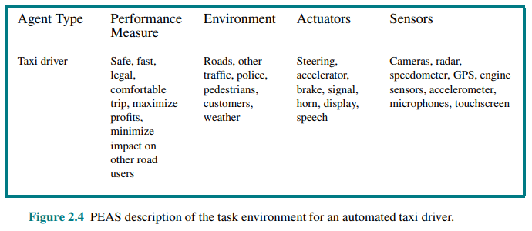
SPECIFYING THE TASK ENVIRONMENT: PEAS DESCRIPTION

Slide 22
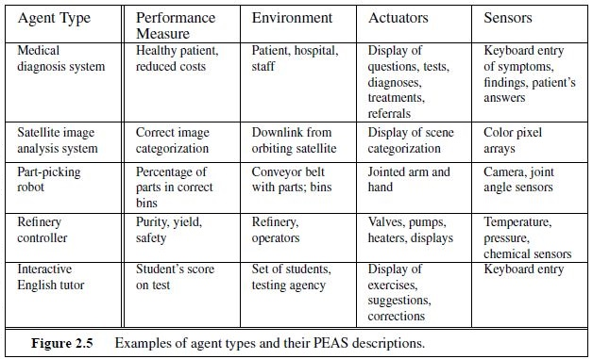
PEAS: Examples

Slide 23
PROPERTIES OF TASK ENVIRONMENT
Fully observable vs. partially observable: If an agent’s sensors give it access to the complete state of the environment at each point in time, then we say that the task environment is fully observable. A task environment is effectively fully observable if the sensors detect all aspects that are relevant to the choice of action; relevance. Fully observable environments are convenient because the agent need not maintain any internal state to keep track of the world.
An environment might be partially observable because of noisy and inaccurate sensors or because parts of the state are simply missing from the sensor data—for example, a vacuum agent with only a local dirt sensor cannot tell whether there is dirt in other squares, and an automated taxi cannot see what other drivers are thinking. If the agent has no sensors at all then the environment is unobservable.

Slide 24
PROPERTIES OF TASK ENVIRONMENT
We say an environment is uncertain if it is not fully observable or not deterministic.
In our use of the word “stochastic” generally implies that uncertainty about outcomes is quantified in terms of probabilities; a nondeterministic environment is one in which actions are characterized by their possible outcomes, but no probabilities are attached to them.

Slide 25
PROPERTIES OF TASK ENVIRONMENT
Single agent vs. multi-agent: The distinction between single-agent and multi-agent environments may seem simple enough. For example, an agent solving a crossword puzzle by itself is clearly in a single-agent environment, whereas an agent playing chess is in a two-agent environment.
Deterministic vs. stochastic. If the next state of the environment is completely determined by the current state and the action executed by the agent, then we say the environment is deterministic; otherwise, it is stochastic.
In principle, an agent need not worry about uncertainty in a fully observable, deterministic environment. If the environment is partially observable, however, then it could appear to be stochastic.

Slide 26
PROPERTIES OF TASK ENVIRONMENT
Episodic vs. sequential: In an episodic task environment, the agent’s experience is divided into atomic episodes. In each episode the agent receives a percept and then performs a single action. Crucially, the next episode does not depend on the actions taken in previous episodes. Many classification tasks are episodic.
For example, an agent that has to spot defective parts on an assembly line bases each decision on the current part, regardless of previous decisions; moreover, the current decision doesn’t affect whether the next part is defective. In sequential environments, on the other hand, the current decision could affect all future decisions. Chess and taxi driving are sequential: in both cases, short-term actions can have long-term consequences.
Episodic environments are much simpler than sequential environments because the agent does not need to think ahead.

Slide 27
PROPERTIES OF TASK ENVIRONMENT
Static vs. dynamic: If the environment can change while an agent is deliberating, then we say the environment is dynamic for that agent; otherwise, it is static.
Static environments are easy to deal with because the agent need not keep looking at the world while it is deciding on an action, nor need it worry about the passage of time.
Dynamic environments, on the other hand, are continuously asking the agent what it wants to do; if it hasn’t decided yet, that counts as deciding to do nothing.

Slide 28
PROPERTIES OF TASK ENVIRONMENT
Discrete vs. continuous: The discrete/continuous distinction applies to the state of the environment, to the way time is handled, and to the percepts and actions of the agent.
For example, the chess environment has a finite number of distinct states. Chess also has a discrete set of percepts and actions.
Taxi driving is a continuous-state and continuous-time problem: the speed and location of the taxi and of the other vehicles sweep through a range of continuous values and do so smoothly over time. Taxi-driving actions are also continuous (steering angles, etc.).
Input from digital cameras is discrete, strictly speaking, but is typically treated as representing continuously varying intensities and locations.

Slide 29
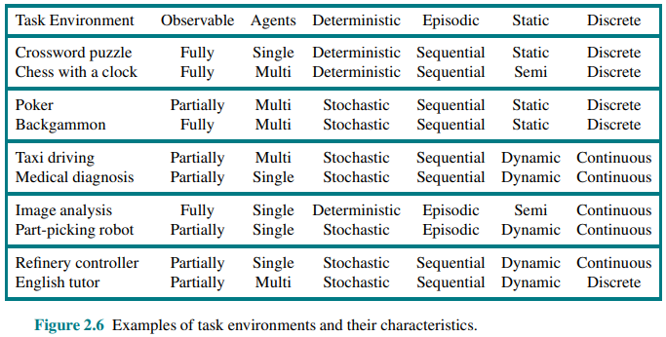
TASK ENVIRONMENT: EXAMPLES

Slide 30
THE STRUCTURE OF AGENTS
The job of AI is to design an agent program that implements the agent function— the mapping from percepts to actions.
We assume this program will run on some sort of computing device with physical sensors and actuators—we call this the architecture:
agent = architecture + program
Obviously, the program we choose has to be one that is appropriate for the architecture. If the program is going to recommend actions like Walk, the architecture had better have legs. The architecture might be just an ordinary PC, or it might be a robotic car with several onboard computers, cameras, and other sensors.

Slide 31
AGENT EXAMPLE: TABLE DRIVEN AGENT
Table-driven agents: It consists in a lookup table of actions to be taken for every possible state of the environment.
If the environment has n variables, each with t possible states, then the table size is t^{n}.
Only works for a small number of possible states for the environment.

Slide 32
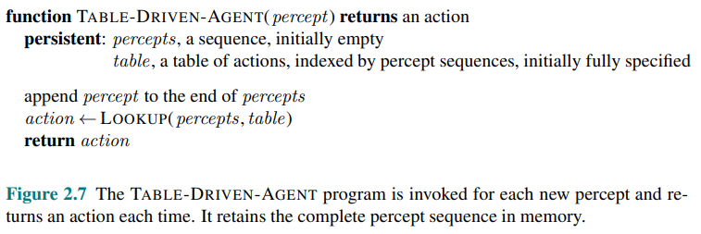
TABLE-DRIVEN-AGENT

Slide 33
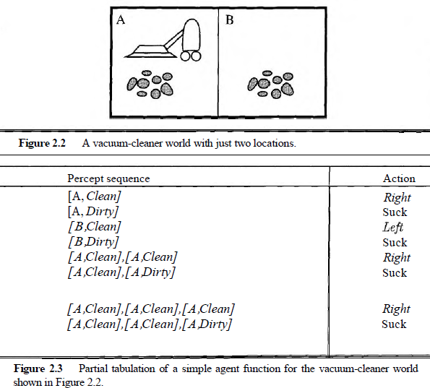
VACUUM CLEANING AGENT: Table Driven

Slide 34
LIMITATION OF TABLE-DRIVEN AGENT
No physical agent in this universe will have the space to store the table,
No agent could ever learn all the right table entries from its experience, and
Even if the environment is simple enough to yield a feasible table size, the designer still has no guidance about how to fill in the table entries

Slide 35
BASIC KINDS OF AGENT PROGRAMS
Simple reflex agents
Model-based reflex agents
Goal-based agents
Utility-based agents.

Slide 36
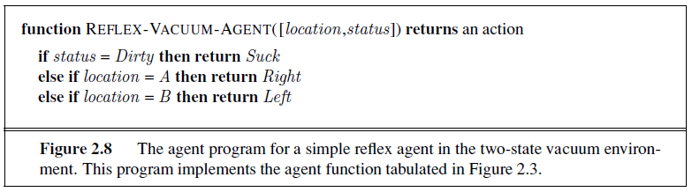
SIMPLE REFLEX AGENTS
select actions on the basis of the current percept, ignoring the rest of the percept history.
a condition-action rule, written as
if car-in-front-is-braking then initiate-braking.
general and flexible approach is first to build a general-purpose interpreter for condition-action rules and then to create rule sets for specific task environments.

Slide 37
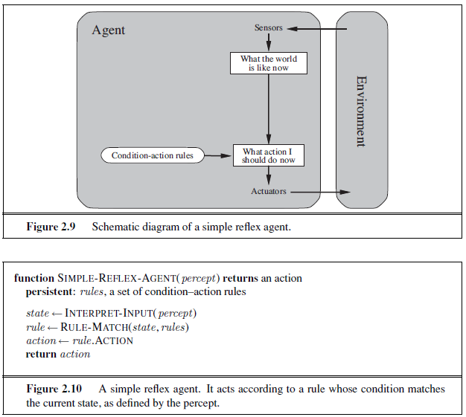
Problem??
Infinite Loop in Deterministic
SRA
Solution??
Randomized SRA
Works only if the Environment is
Fully Observable
What will happen? when,
Vacuum Cleaner with poor perception!
Without location sensor !

Slide 38
SIMPLE REFLEX AGENTS
Simple reflex agents have the admirable property of being simple, but they turn out to be of limited intelligence.
The agent in Figure 2.10 will work only if the correct decision can be made based on only the current percept—that is, only if the environment is fully observable.
Even a little bit of unobservability can cause serious trouble.

Slide 39
MODEL-BASED REFLEX AGENTS
keep track of the part of the world it can't see now. [handle partial observability]
That is, the agent should maintain some sort of internal state that depends on the percept history and thereby reflects at least some of the unobserved aspects of the current state.
Updating this internal state information as time goes by requires two kinds of knowledge to be encoded in the agent program.
First, we need some information about how the world evolves independently of the agent-- for example, that an overtaking car generally will be closer behind than it was a moment ago.

Slide 40
MODEL-BASED REFLEX AGENTS
Second, we need some information about how the agent’s own actions affect the world—for example, that when the agent turns the steering wheel clockwise, the car turns to the right, or that after driving for five minutes northbound on the freeway, one is usually about five miles north of where one was five minutes ago.
This knowledge about “how the world works”—whether implemented in simple Boolean circuits or in complete scientific theories—is called a model of the world. An agent that uses such a model is called a model-based agent.

Slide 41
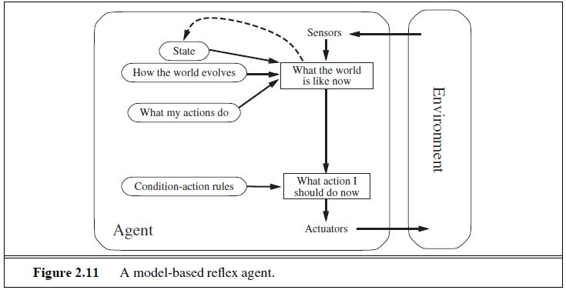
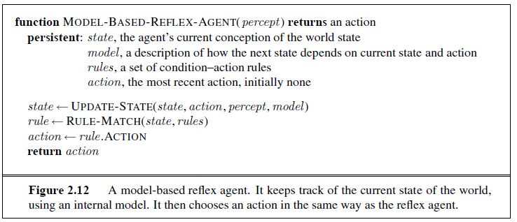
MODEL-BASED REFLEX AGENTS

Slide 42
GOAL-BASED AGENT
Knowing something about the current state of the environment is not always enough to decide what to do.
For example, at a road junction, the taxi can turn left, turn right, or go straight on. The correct decision depends on where the taxi is trying to get to. In other words, as well as a current state description, the agent needs some sort of goal information that describes situations that are desirable—for example, being at the passenger’s destination.
The agent program can combine this with the model (the same information as was used in the model-based reflex agent) to choose actions that achieve the goal.

Slide 43
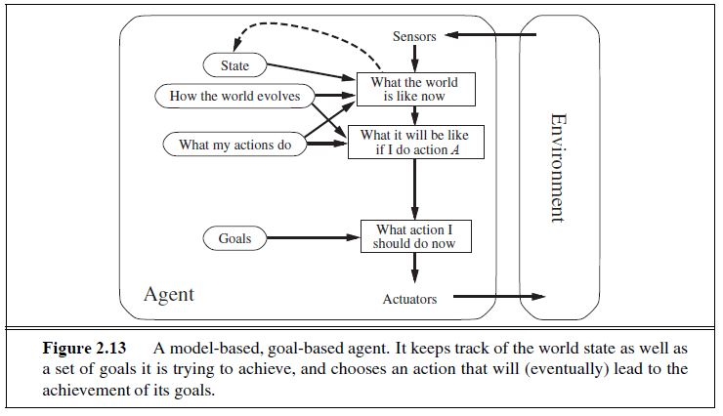
GOAL-BASED AGENT

Slide 44
GOAL-BASED AGENT
Sometimes goal-based action selection is straightforward—for example, when goal satisfaction results immediately from a single action.
Sometimes it will be more tricky—for example, when the agent has to consider long sequences of twists and turns in order to find a way to achieve the goal.
Search (Chapters 3 to 5) and planning (Chapters 10 and 11) are the subfields of AI devoted to finding action sequences that achieve the agent’s goals.
The goal-based agent’s behavior can easily be changed to go to a different destination, simply by specifying that destination as the goal. The reflex agent’s rules for when to turn and when to go straight will work only for a single destination; they must all be replaced to go somewhere new.

Slide 45
UTILITY-BASED AGENTS
Goals alone are not enough to generate high-quality behavior in most environments. For example, many action sequences will get the taxi to its destination (thereby achieving the goal) but some are quicker, safer, more reliable, or cheaper than others.
Goals just provide a crude binary distinction between “happy” and “unhappy” states. A more general performance measure should allow a comparison of different world states according to exactly how happy they would make the agent. Because “happy” does not sound very scientific, economists and computer scientists use the term utility instead.

Slide 46
UTILITY-BASED AGENTS
An agent’s utility function is essentially an internalization of the performance measure. If the internal utility function and the external performance measure are in agreement, then an agent that chooses actions to maximize its utility will be rational according to the external performance measure.
In two kinds of cases, goals are inadequate, but a utility-based agent can still make rational decisions.
when there are conflicting goals, only some of which can be achieved (for example, speed and safety), the utility function specifies the appropriate tradeoff.
when there are several goals that the agent can aim for, none of which can be achieved with certainty, utility provides a way in which the likelihood of success can be weighed against the importance of the goals.

Slide 47
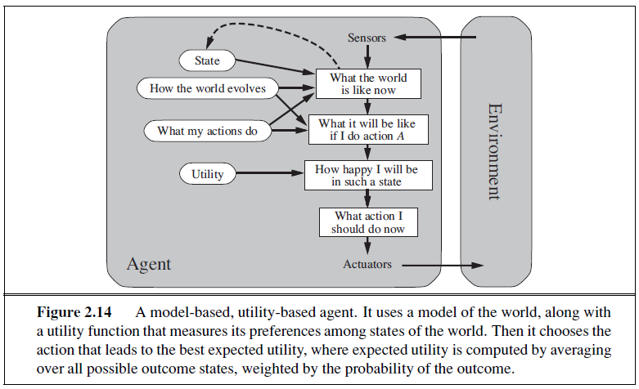

Slide 48
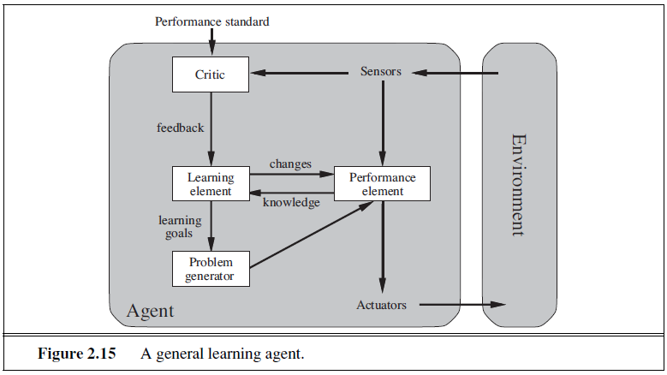
LEARNING AGENT

Slide 49
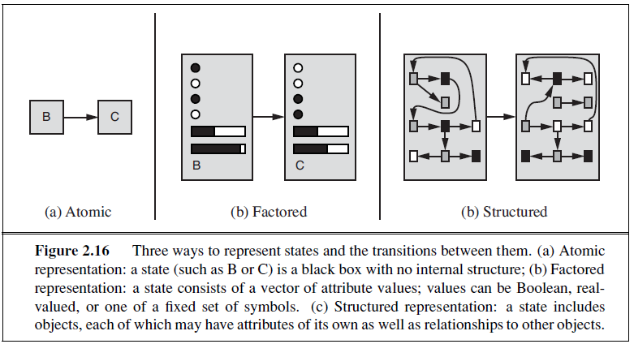
HOW COMPONENT OF AGENT PROGRAMS WORK

Slide 50
References
Chapter 2: Intelligent Agents , Pages 34-58
“Artificial Intelligence: A Modern Approach,” by Stuart J. Russell and Peter Norvig,

Slide 51
Books
“Artificial Intelligence: A Modern Approach,” by Stuart J. Russell and Peter Norvig.
"Artificial Intelligence: Structures and Strategies for Complex Problem Solving", by George F. Luger, (2002)
"Artificial Intelligence: Theory and Practice", by Thomas Dean.
"AI: A New Synthesis", by Nils J. Nilsson.
“Programming for machine learning,” by J. Ross Quinlan,
“Neural Computing Theory and Practice,” by Philip D. Wasserman, .
“Neural Network Design,” by Martin T. Hagan, Howard B. Demuth, Mark H. Beale, .
“Practical Genetic Algorithms,” by Randy L. Haupt and Sue Ellen Haupt.
“Genetic Algorithms in Search, optimization and Machine learning,” by David E. Goldberg.
"Computational Intelligence: A Logical Approach", by David Poole, Alan Mackworth, and Randy Goebel.
“Introduction to Turbo Prolog”, by Carl Townsend.

